Slide 1
Effects of NBA Schedule on game results
Mitchell Jones
CS-5483 Network Science Project Proposal

Slide 2
Problem statement
What is the effect of the order on the NBA schedule on game results?
How does the number of rest days impact the number of games won and point differential over a defined period of games?
How does traveling from a specific city to another impact the number of games won and point differential over a defined period of games?
Period of games for both is 1, 2, 3, and 5 games
May be changed later depending on any trends found in analysis

Slide 3
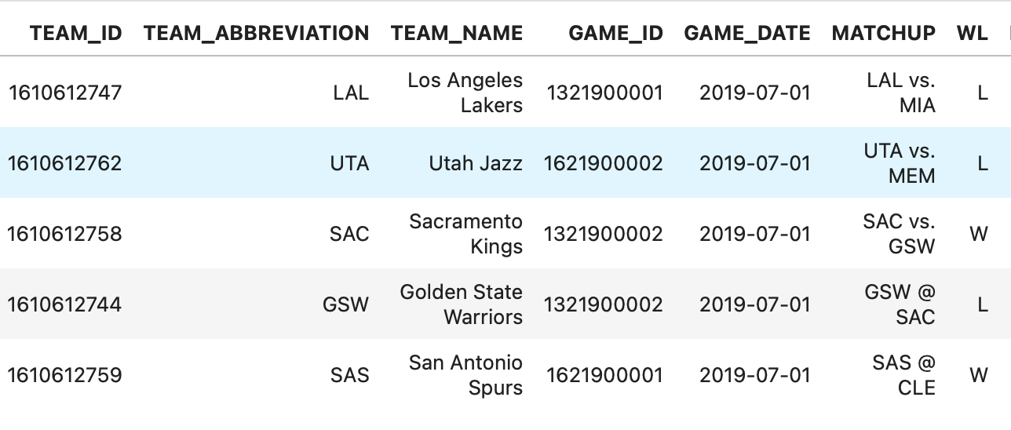
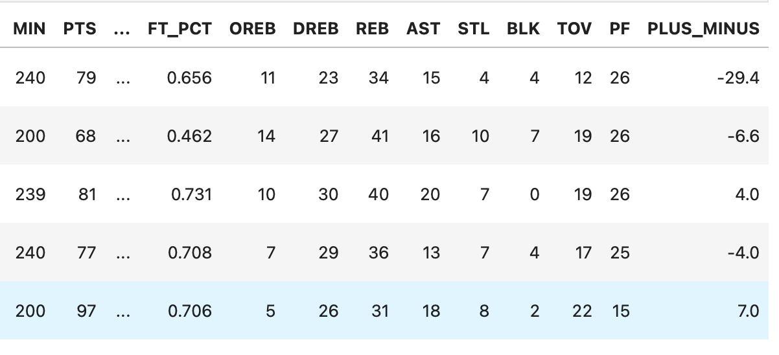
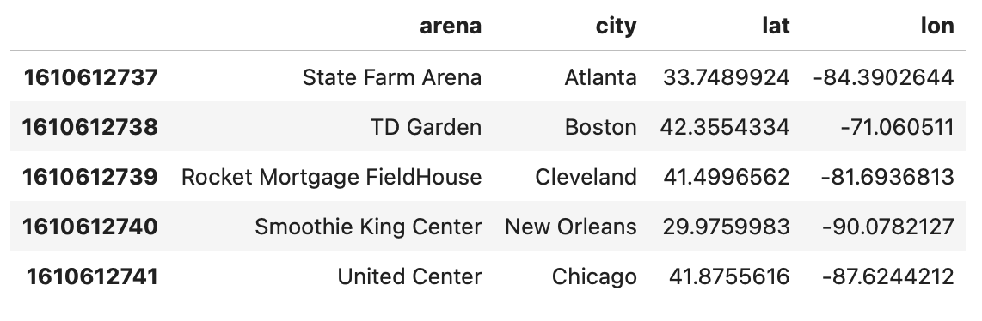
Datasets
NBA API – Easier Access to Official NBA Stats
Individual Game Stats
Team Arena Latitude/Longitude
Both datasets are Pandas DataFrames made from API endpoint data
Multiple seasons of data will be used for Individual Game Stats

Slide 4
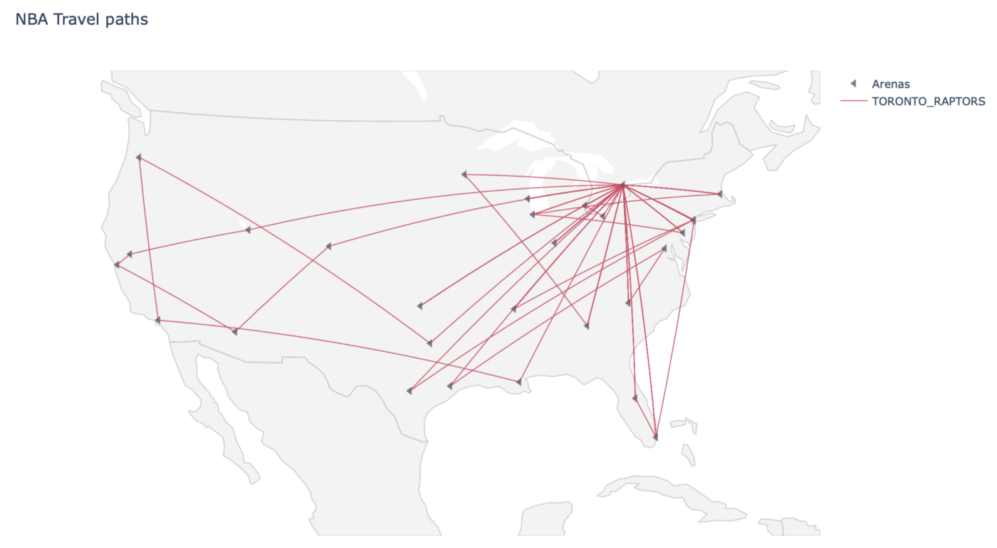
Methodology: Directed NEtwork
Image from JP Hwang

